Slide 1
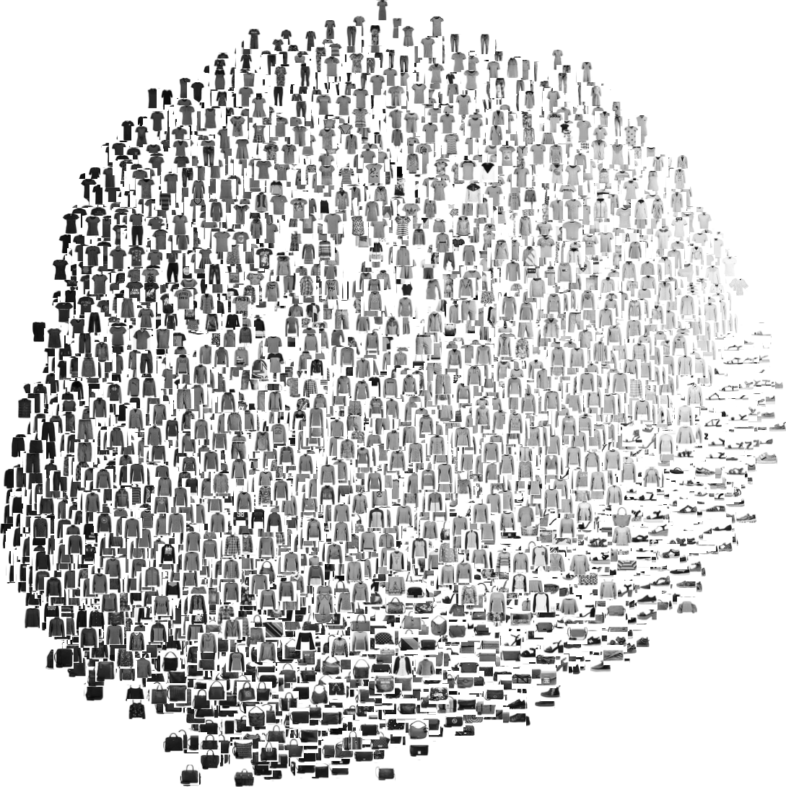
Deep Learning Based Image Classifier
Kamma Rakesh(BL.EN.U4CSE17054)
Kolliparla Bala Vineel(BL.EN.U4CSE17062)
Korupolu Nitya(BL.EN.U4CSE17063)

Slide 2
Abstract
Image Classification is one of the most popular tasks in Deep Learning where we are given a particular image and the model has to predict the class of the image.
Detecting Images and classifying them is a prime application today in all industrial areas whether in Self Driving Vehicles to classify or traffic signals or in Medical Imaging and the list never ends.

Slide 3
Expected Outcome
It’s a picture consisting of how accurately our model had predicted on fashion m_nist dataset by representing them in red and green colors if it is correctly predicted label then its is it in the green color and vice versa respectively
Plotting the graphing of loss vs val_loss and accuracy vs val_accuracy

Slide 4
Tools and algorithms
R
Rstudio
Convolutional Neural Network
Keras,tidyr,ggplot2 libraries
Tensorflow backend engine

Slide 5
Dataset
Here we are using Fashion M_nist dataset having (28 * 28) size gray scale images and it consists of 10 labels namely
1) T-shirt/top 2) Trouser 3) Pullover 4) Dress 5) Coat
6) Sandal 7) Shirt 8) Sneaker 9) Bag 10) Ankle Boot
There are 70,000 images in this dataset
48,000 for Training and 12,000 for validation
10,000 images for testing

Slide 6
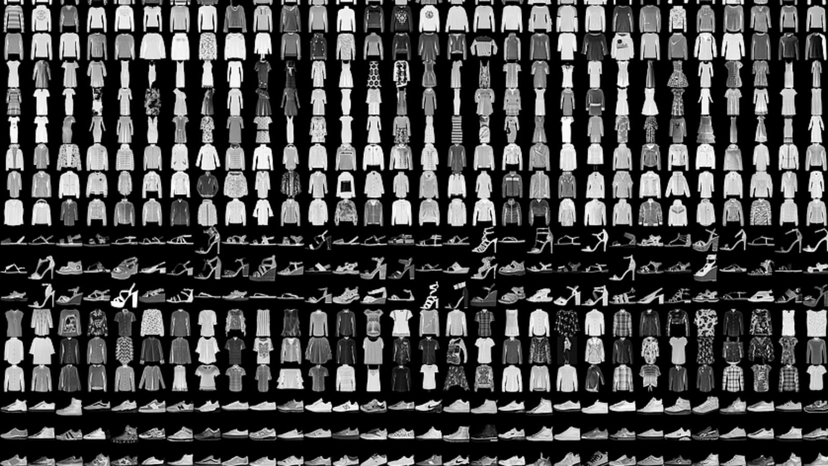

Slide 7
Implementation Phases
Import the fashion mnist dataset
Data exploration
Preprocess the data
Build the model
Compile the model
Train and evaluate the model
Make predictions on test data

Slide 8
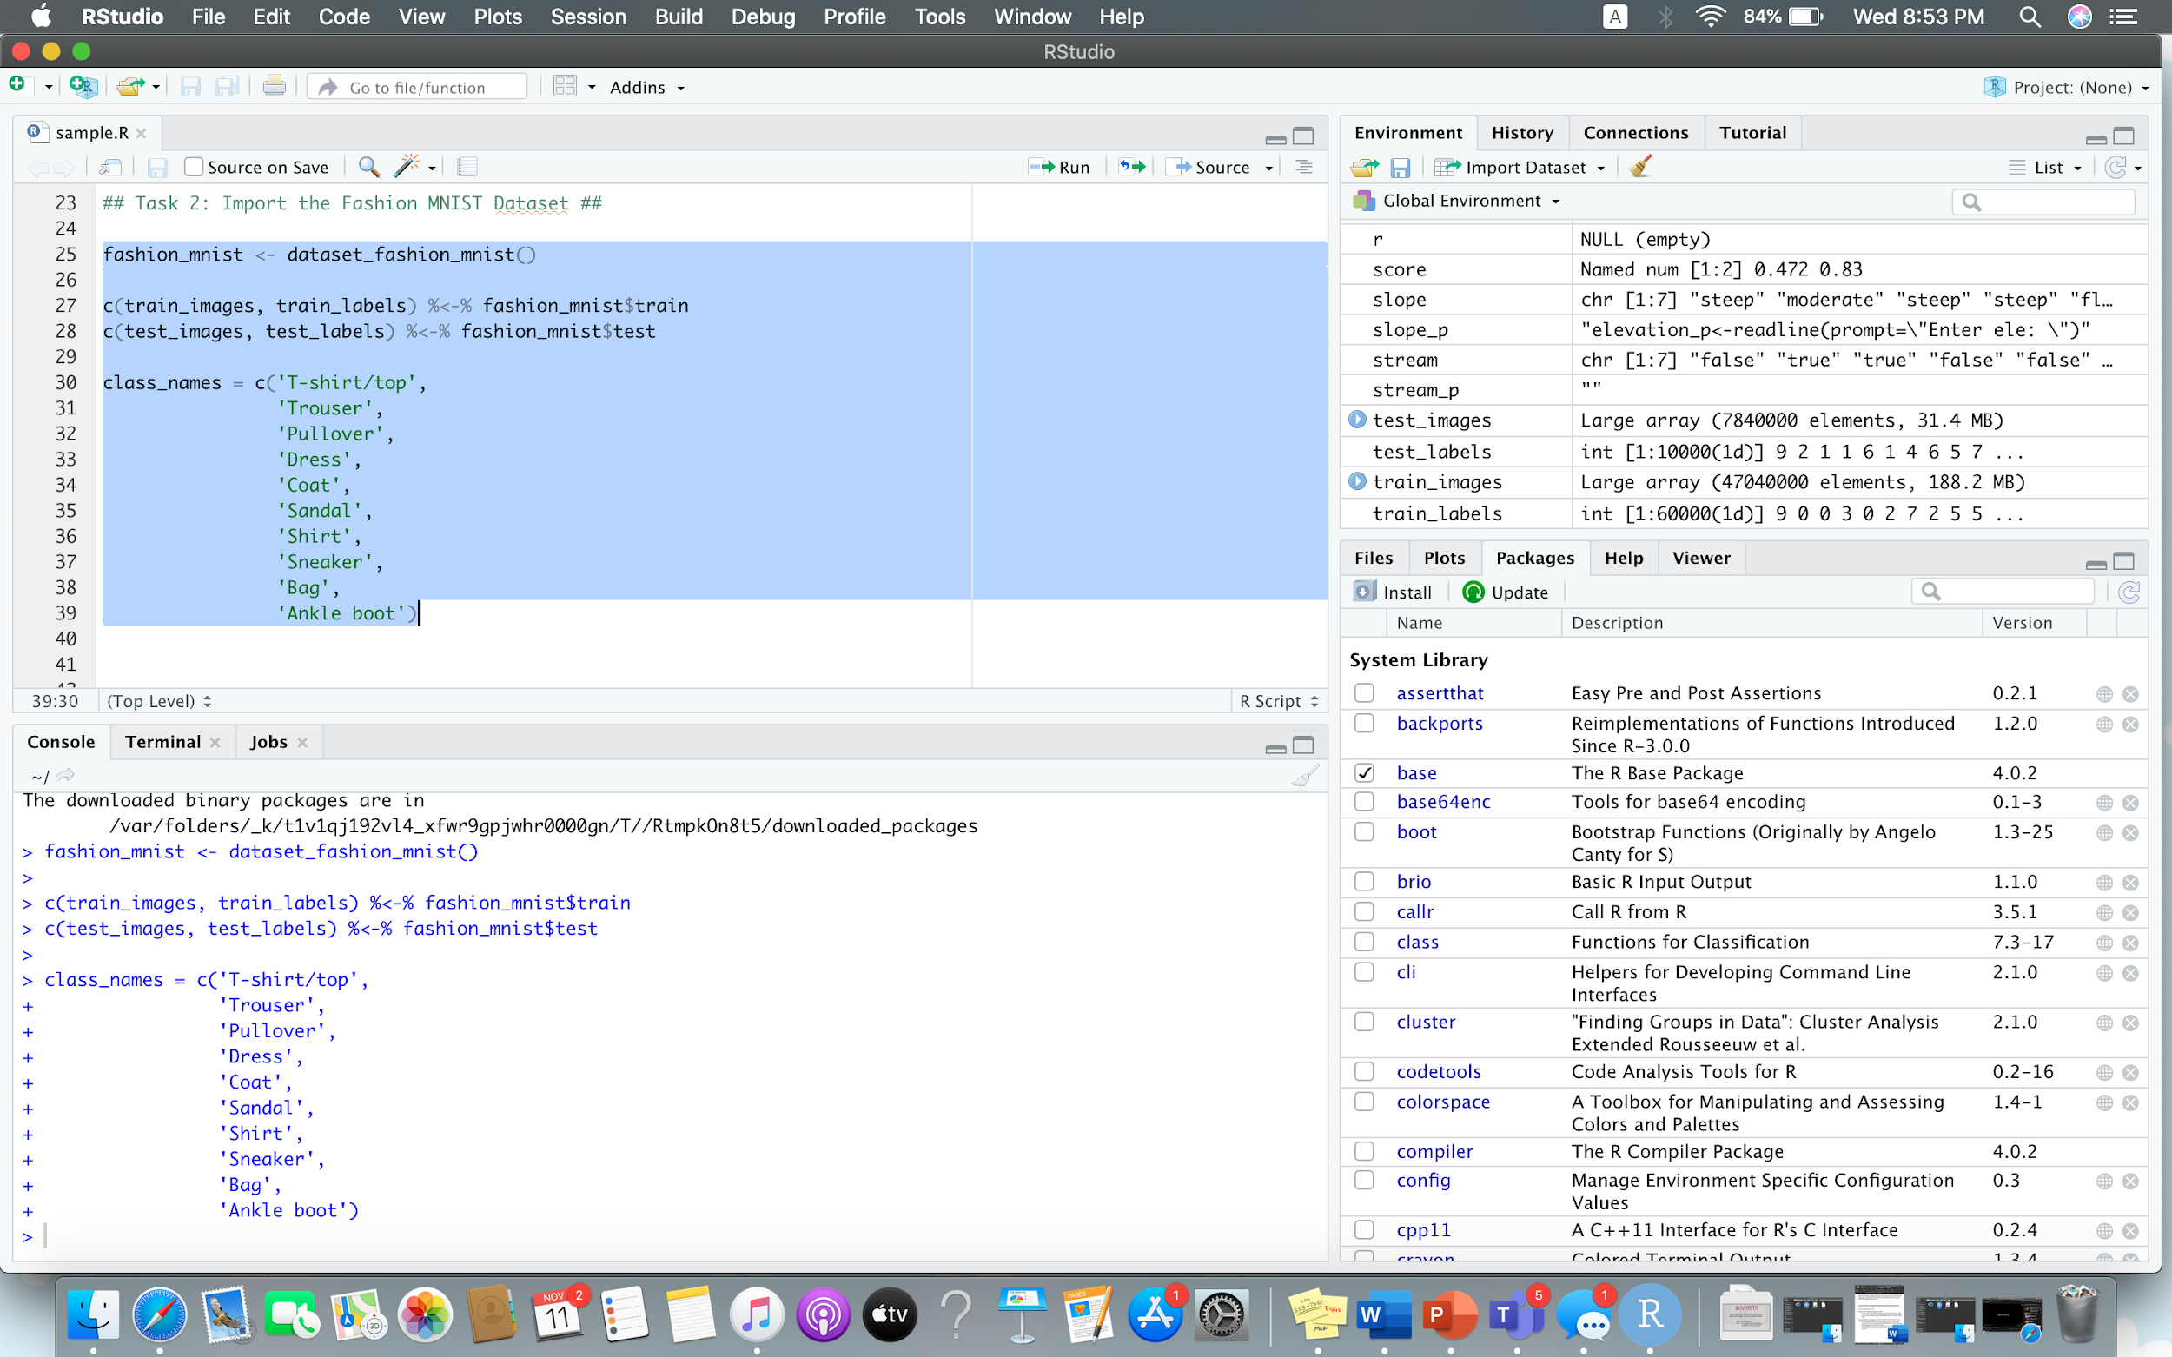
Importing the Fashion_mnist dataset from keras library and splitting the dataset into train and test images along with labels.here we are also specifying the class names

Slide 9
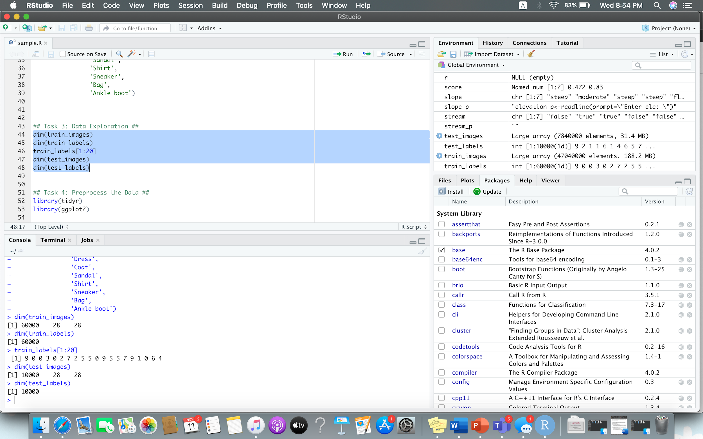
2. Checking the dimensions of train,test images and labels

Slide 10
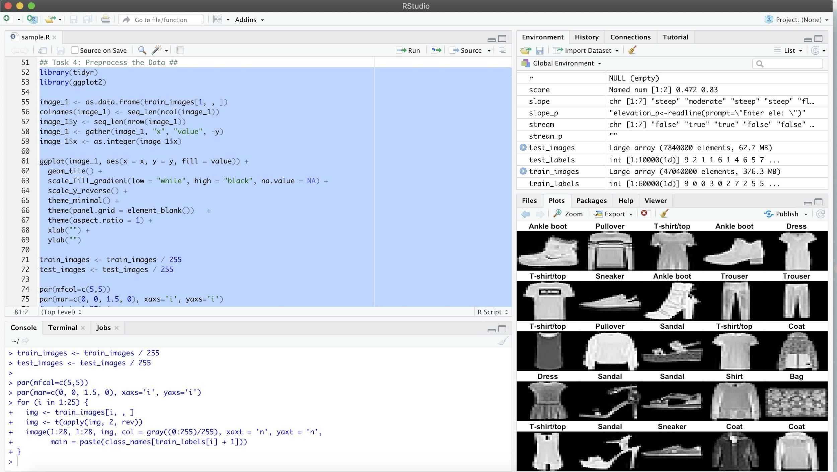
3. The grey scale values range from 0 to 255 so in this pre-processing step we are normalizing the data and feeding it into the neural network which leads to faster training and faster convergence

Slide 11
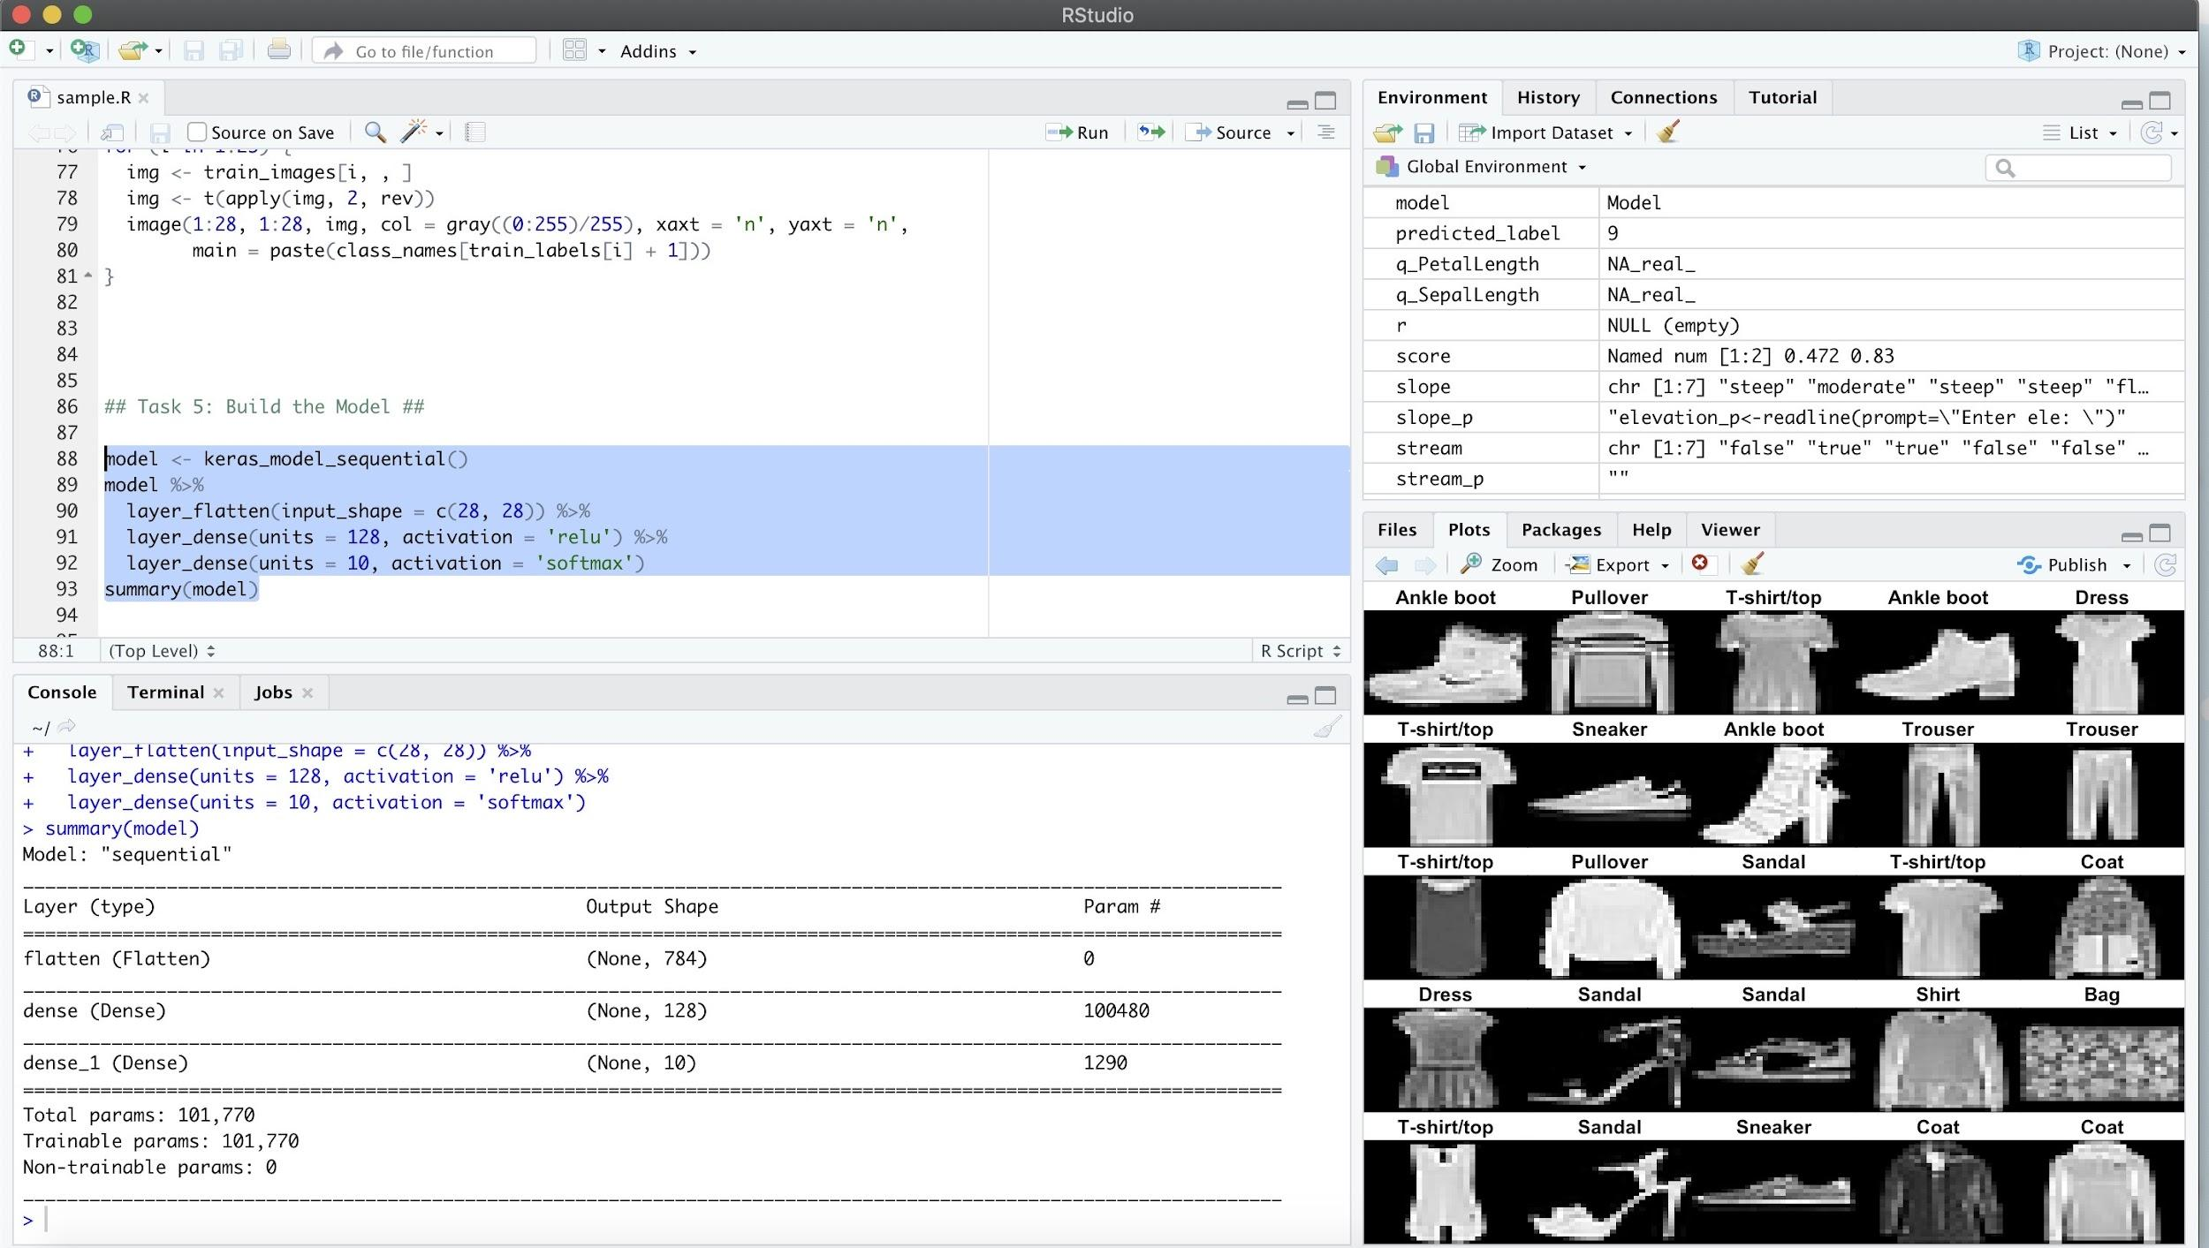
4. Here, there are three layers the first layer is the flatten layer where it is used to convert the 2-d array to vector . The second is a dense layer having nodes=128 and activation function as relu and the output layer is the last layer consisting of 10 nodes and activation function called softmax to find the probabilities of each class label.

Slide 12
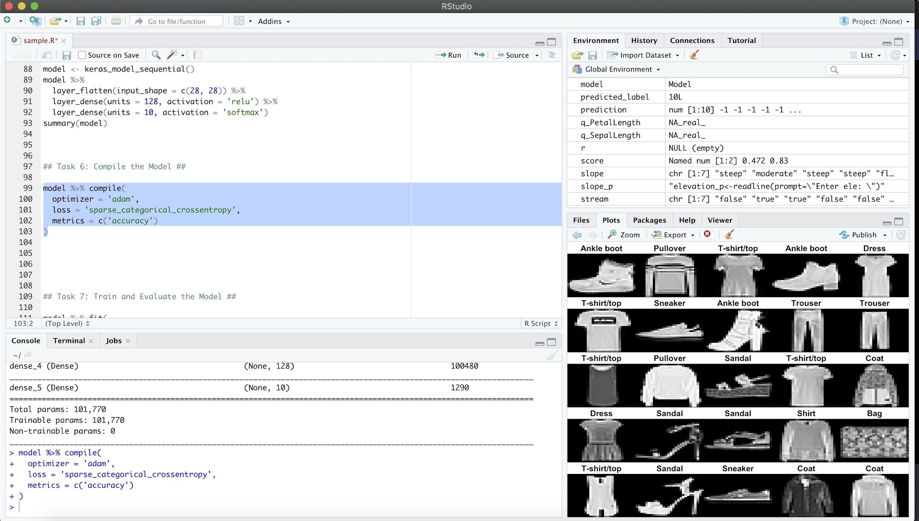
5. Loss function is sparse categorical cross entropy because the labels are ranging from 0 to 9 .Here we used Most commonly used image classification optimizer named as adam optimizer and the metrics are accuracy with the help of these three we are going to compile our model.

Slide 13
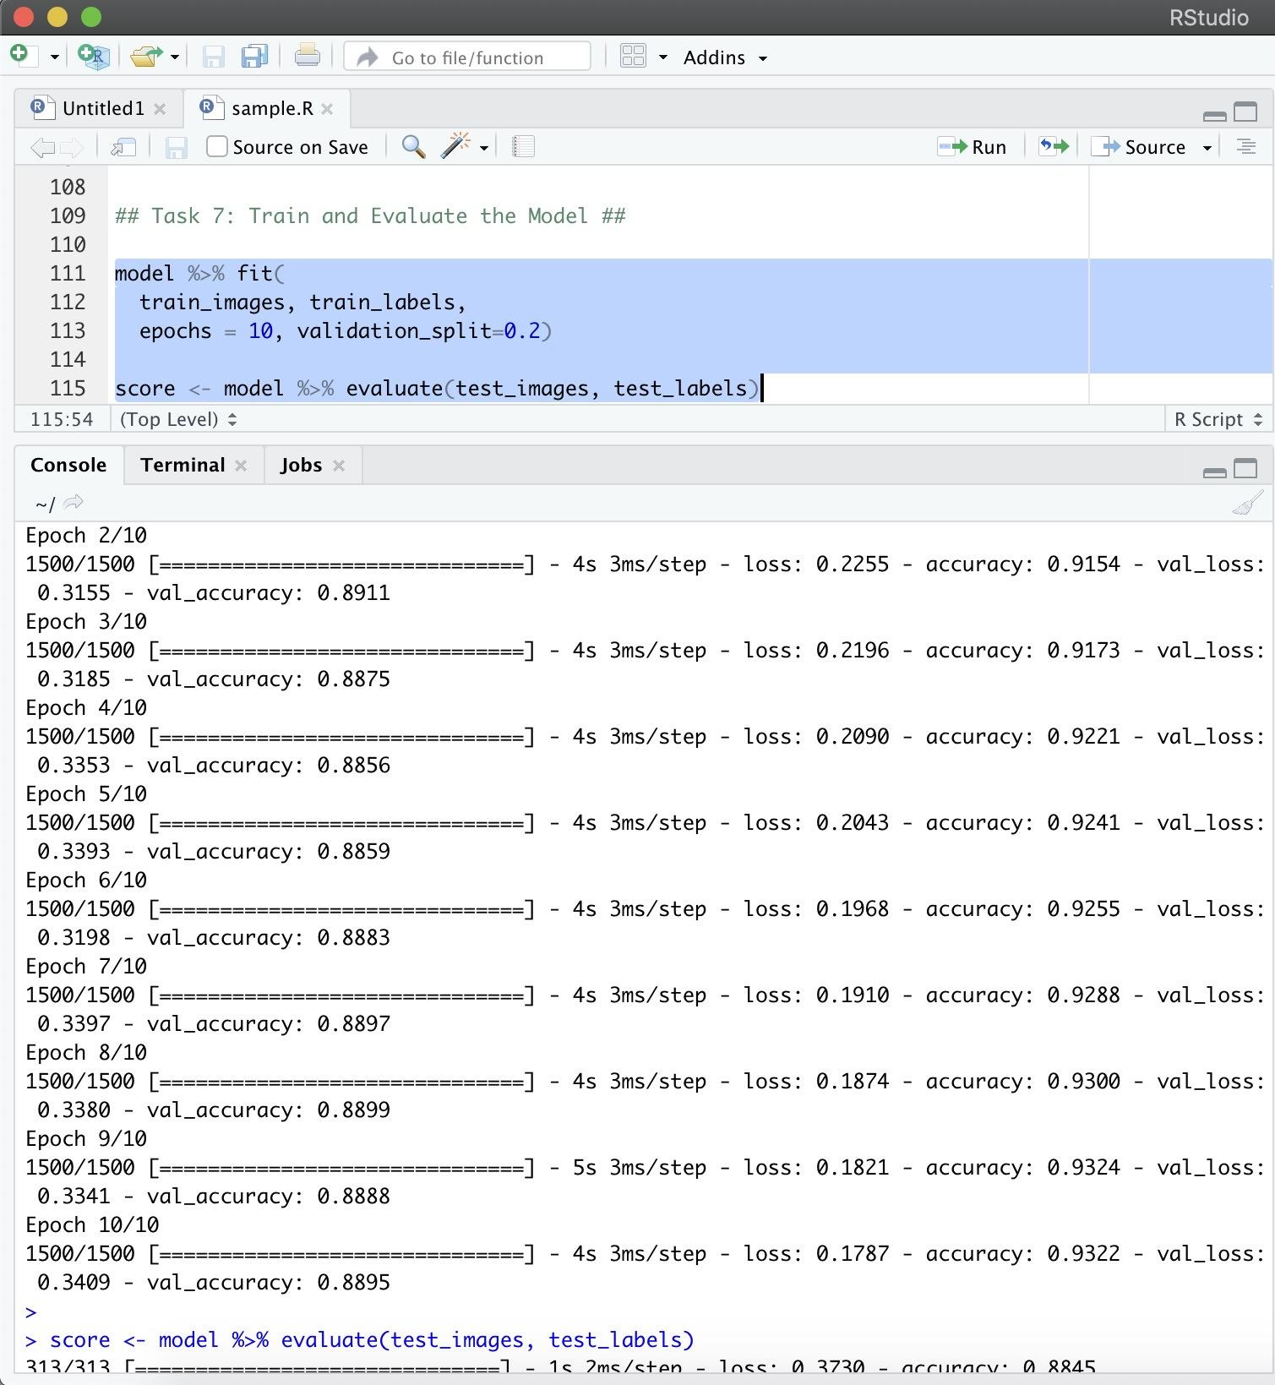
6. In order to train we are dividing the training data into (48000,12000) split for parallely validating the training data and for evaluating the model we are using the .evaluate code snippet and calculating the test loss and accuracy

Slide 14
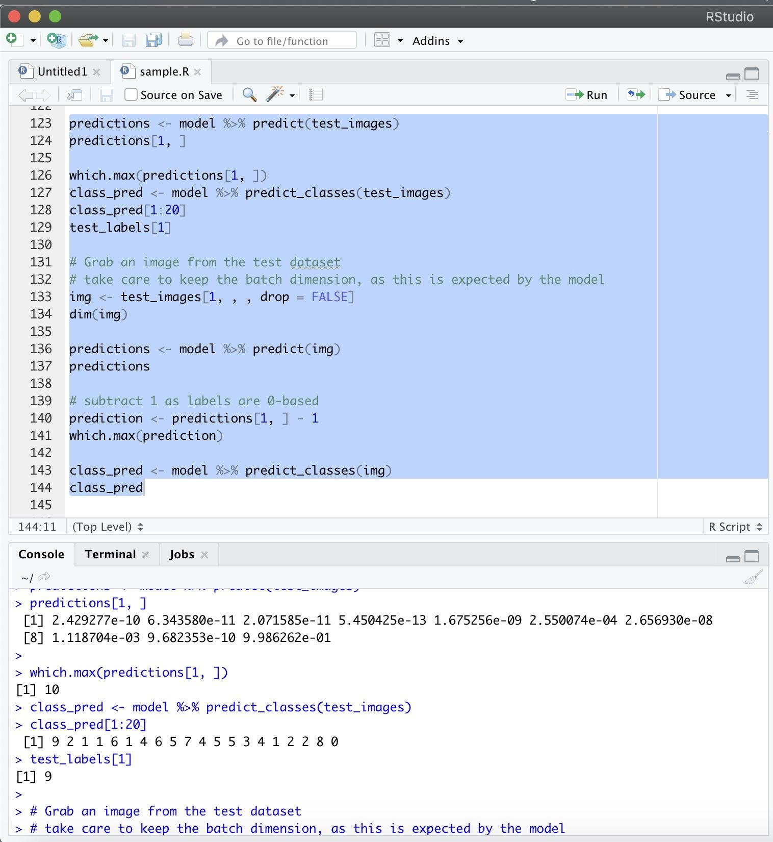
7. Predicting the class labels on test images and comparing it with the original test labels

Slide 15
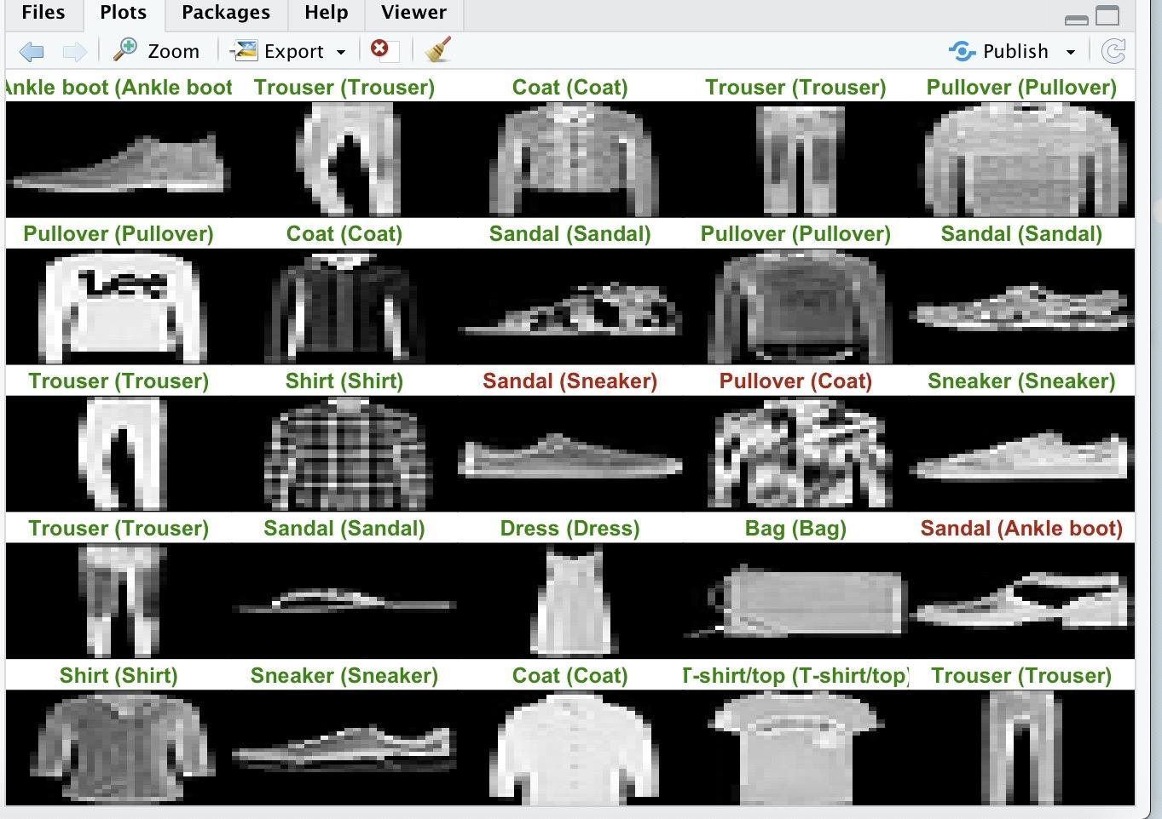
Final output

Slide 16
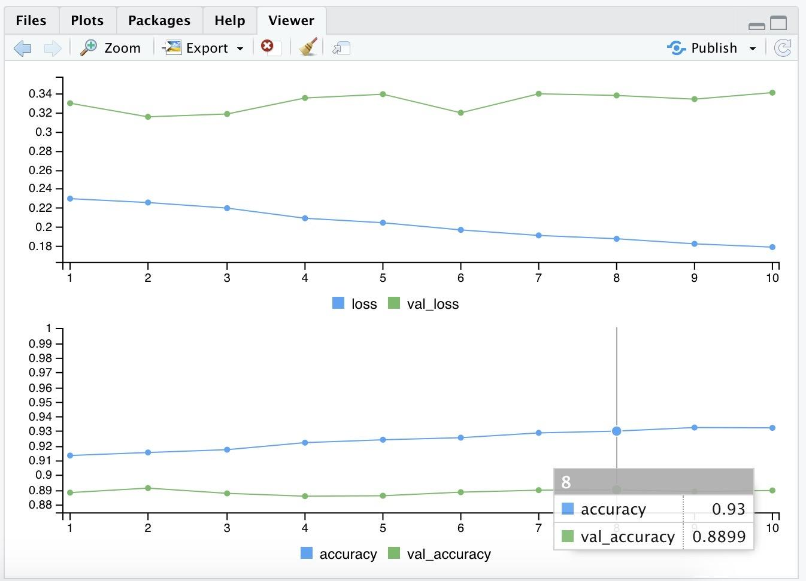
Graphs

Slide 17
Thank you….

